Slide 1
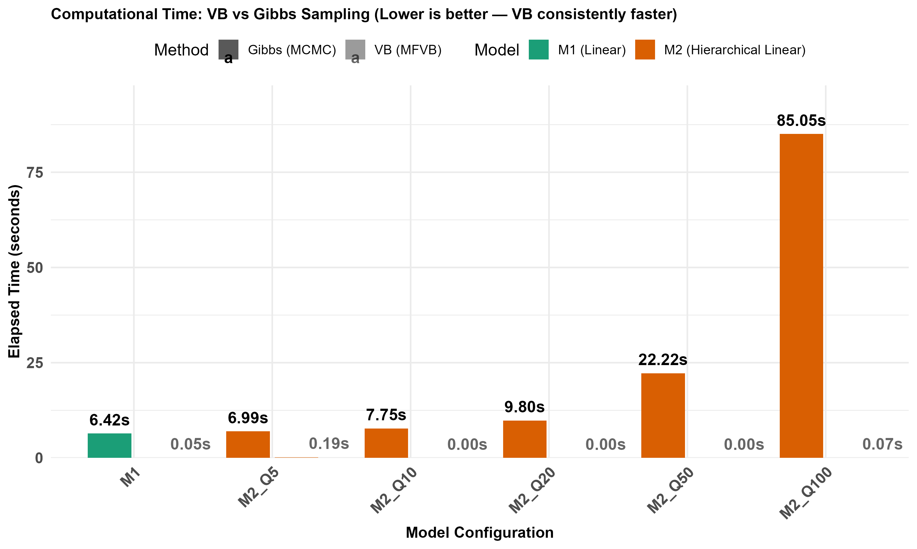

Slide 2
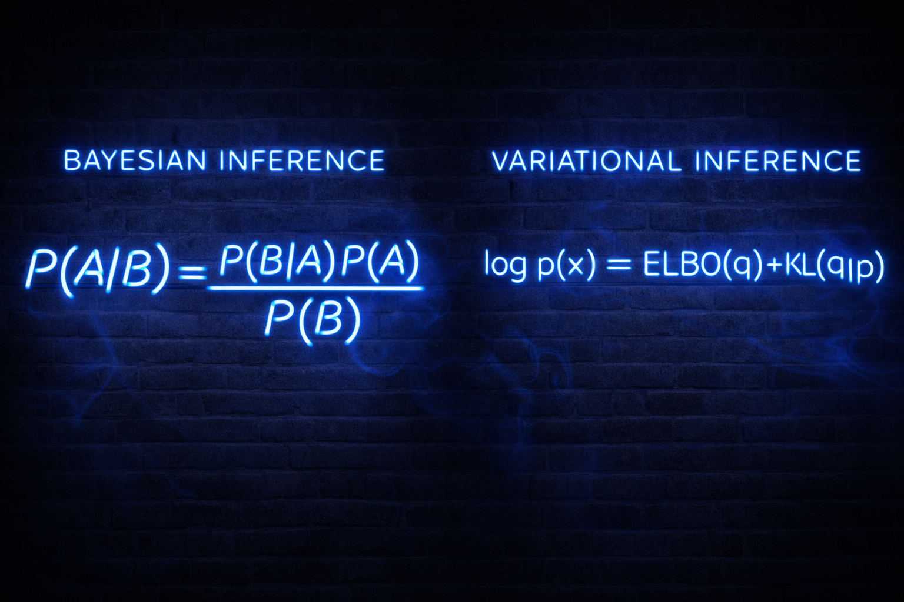

Slide 3
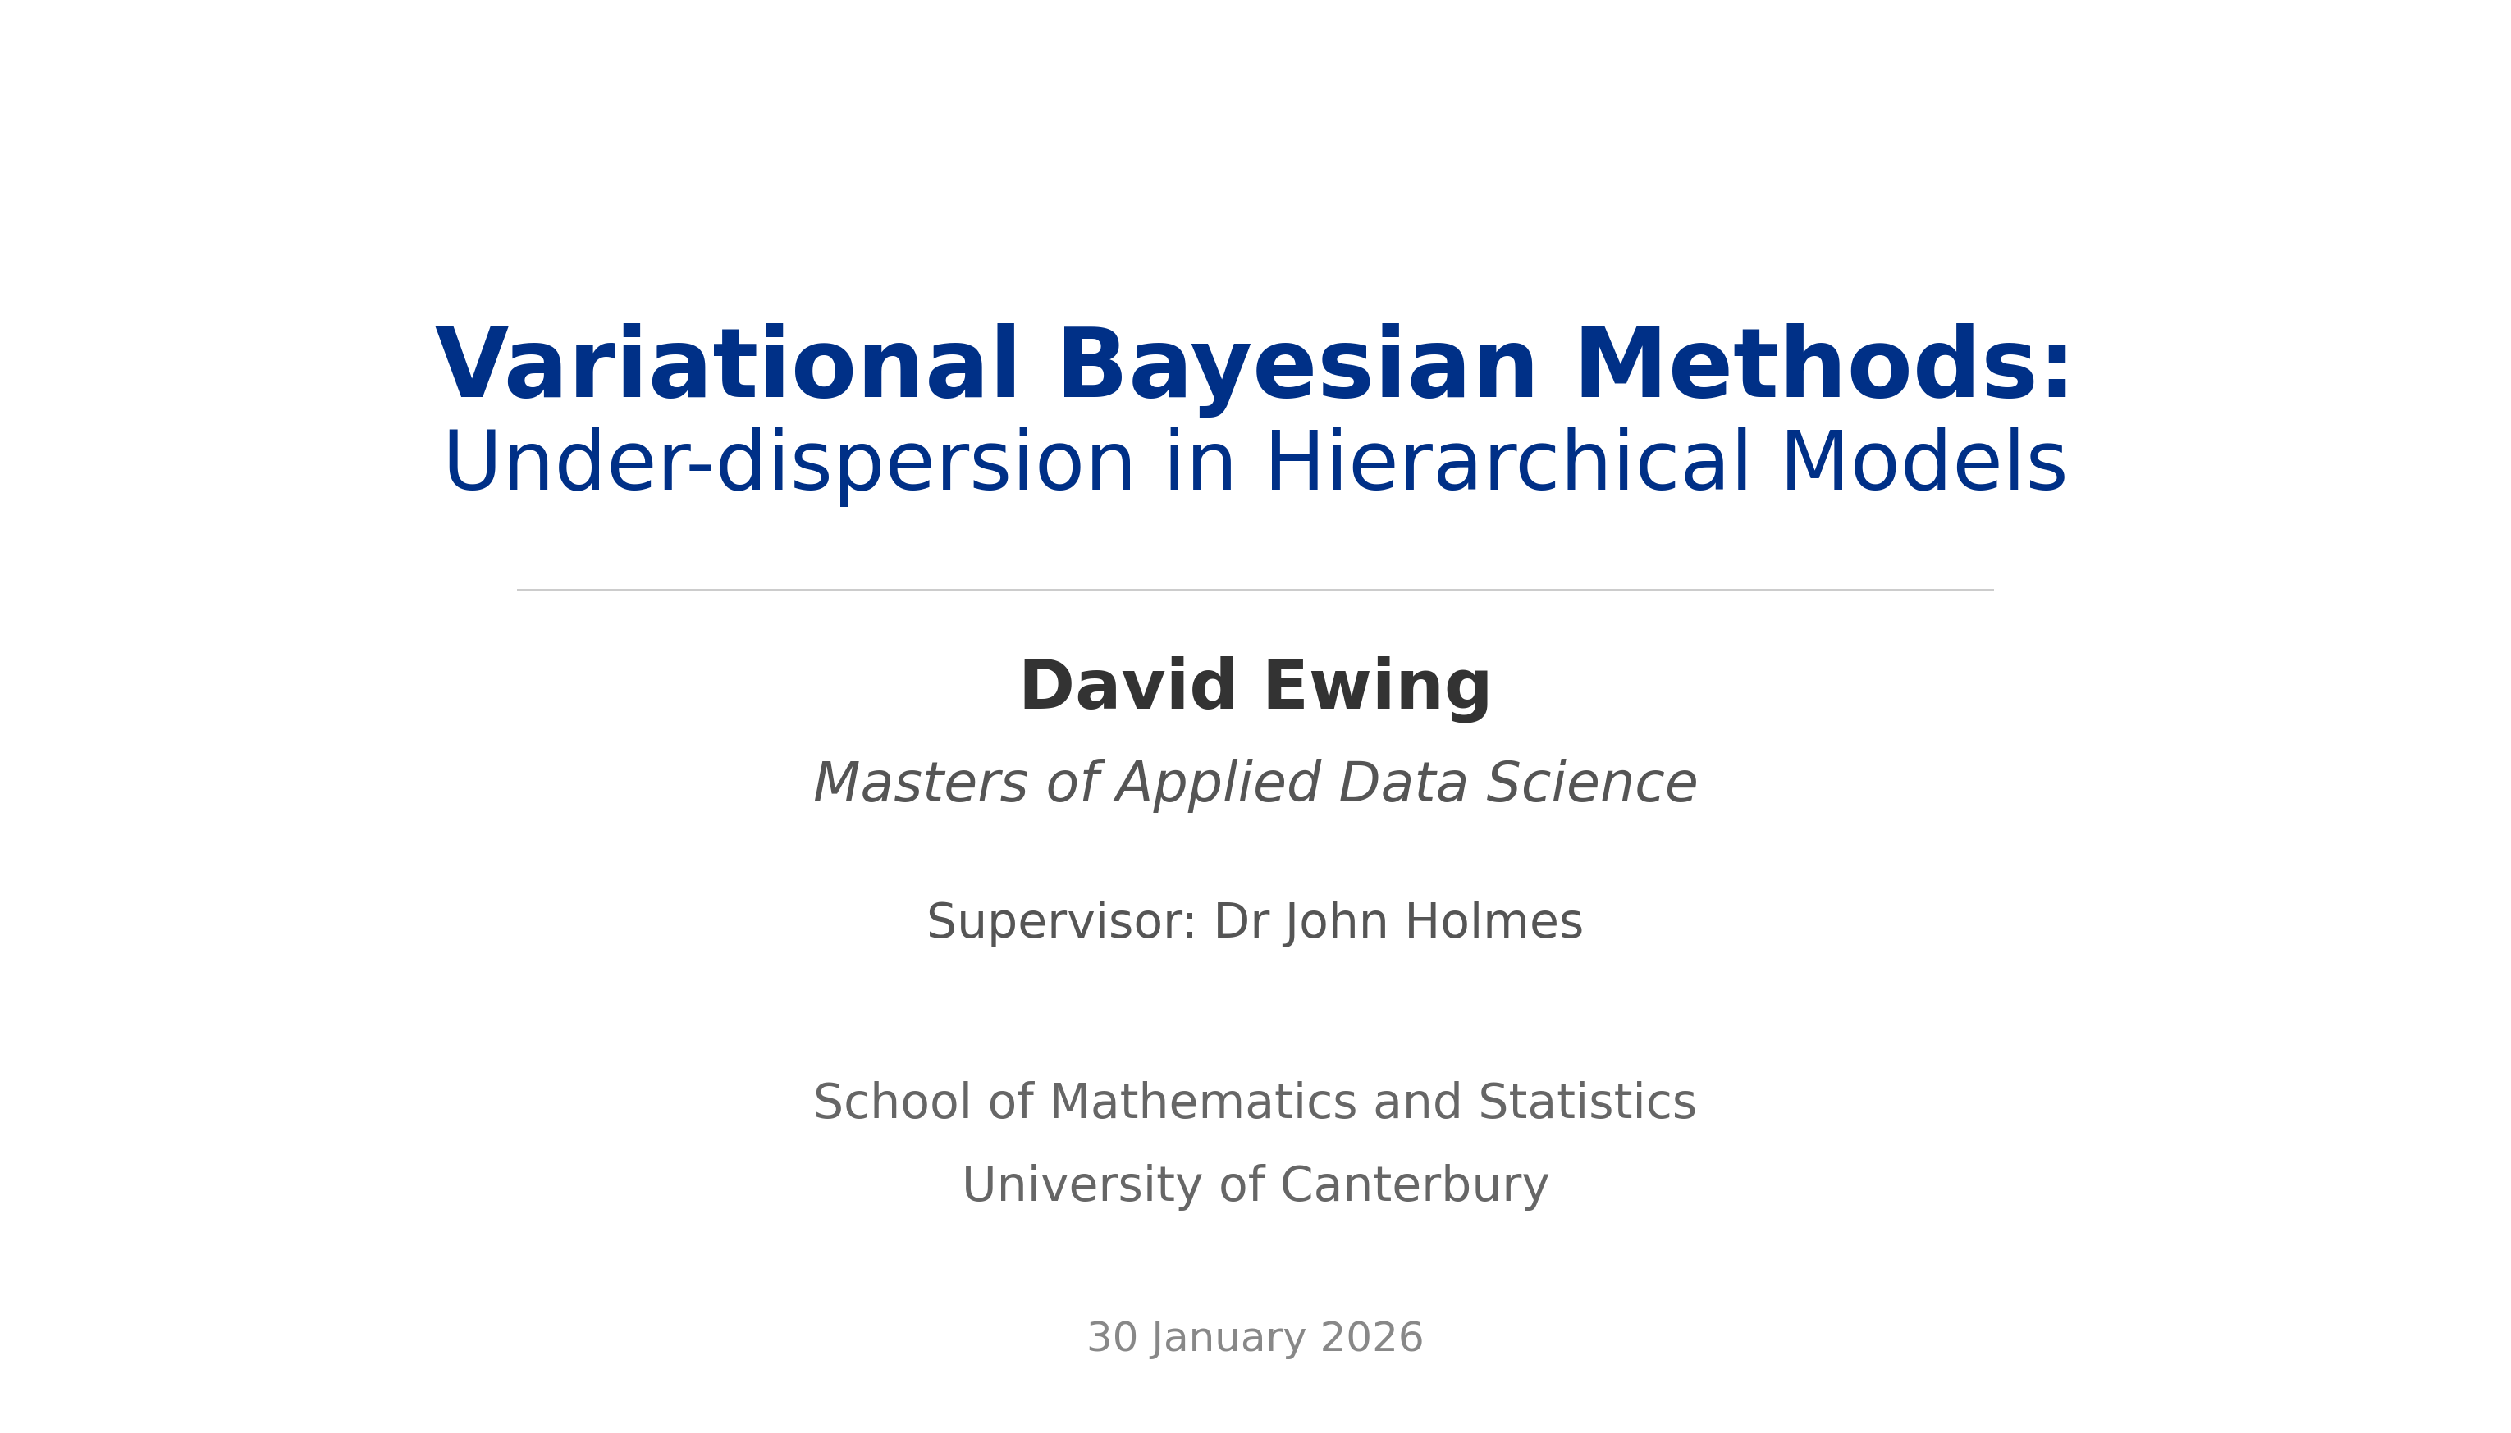

Slide 4
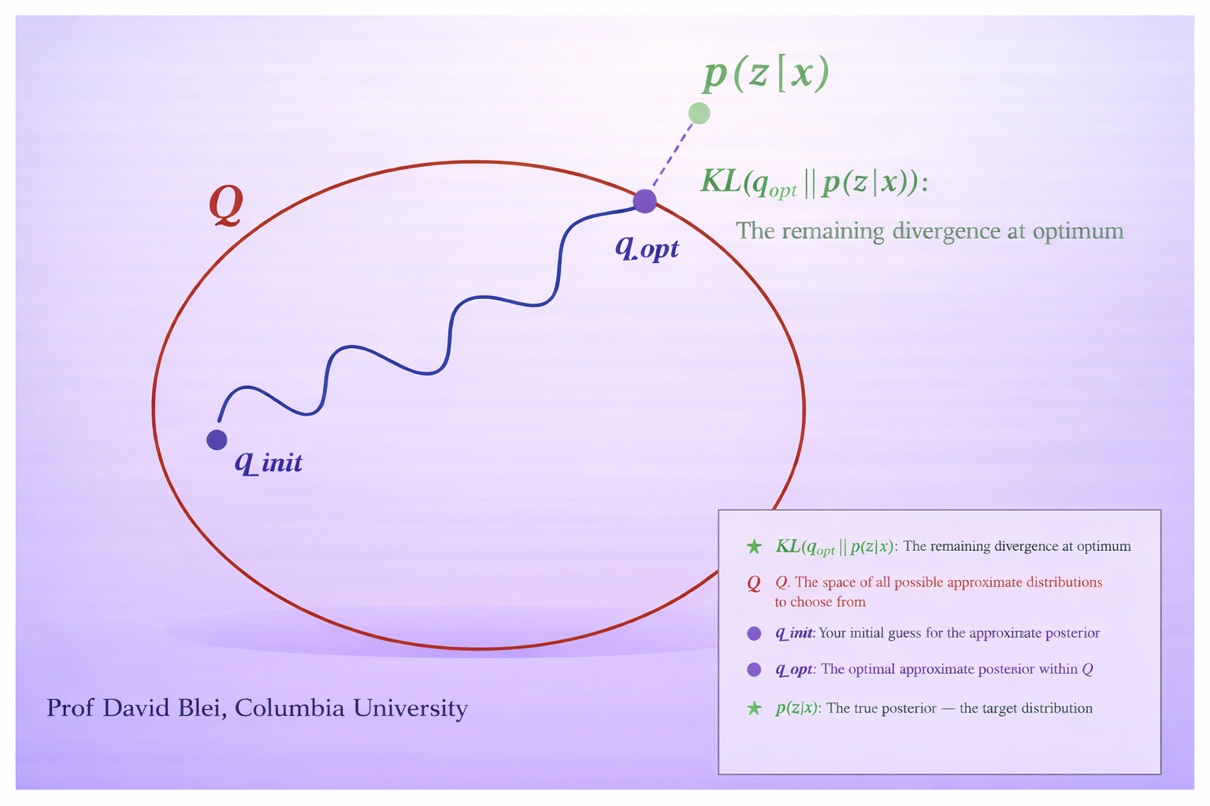

Slide 5
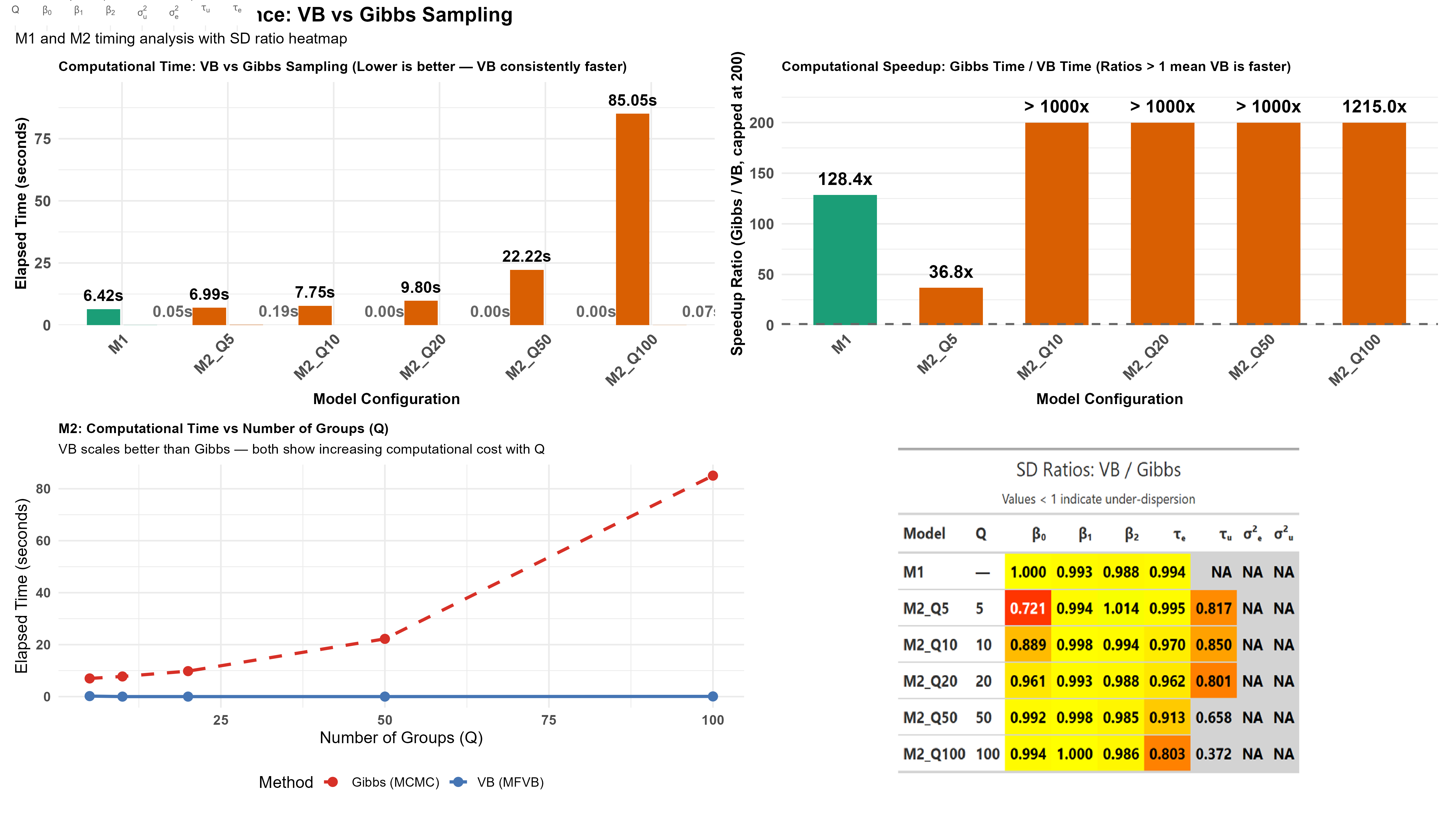

Slide 6
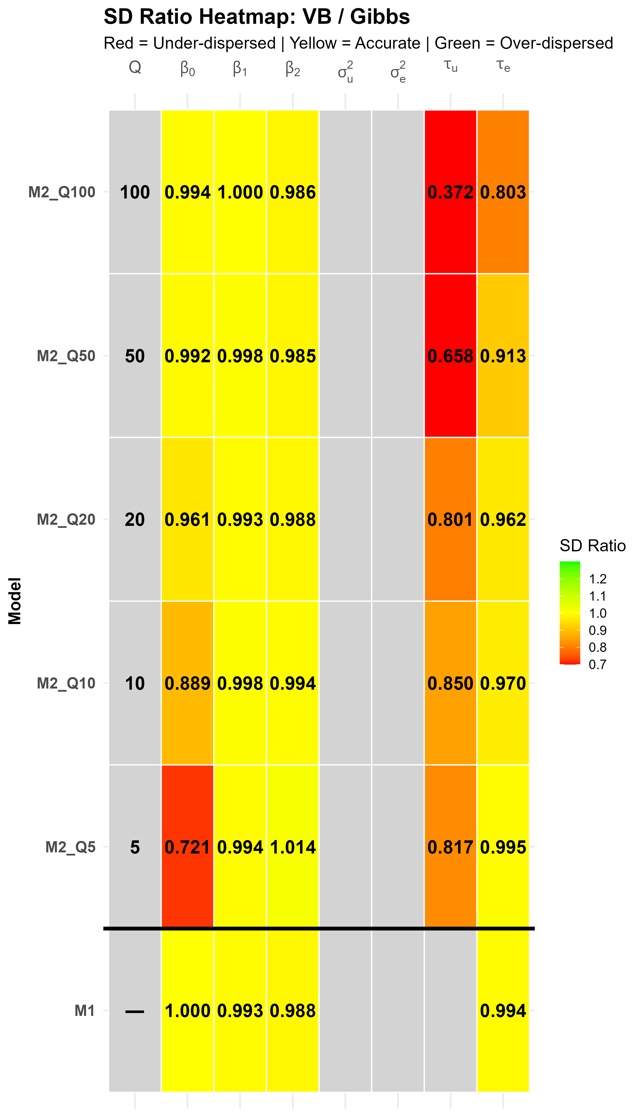

Slide 7
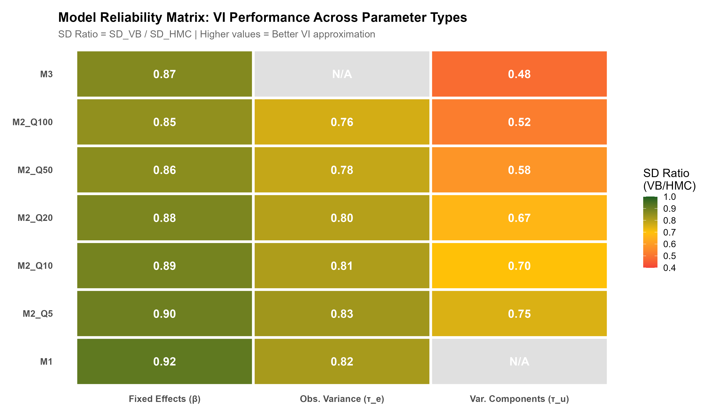

Slide 8
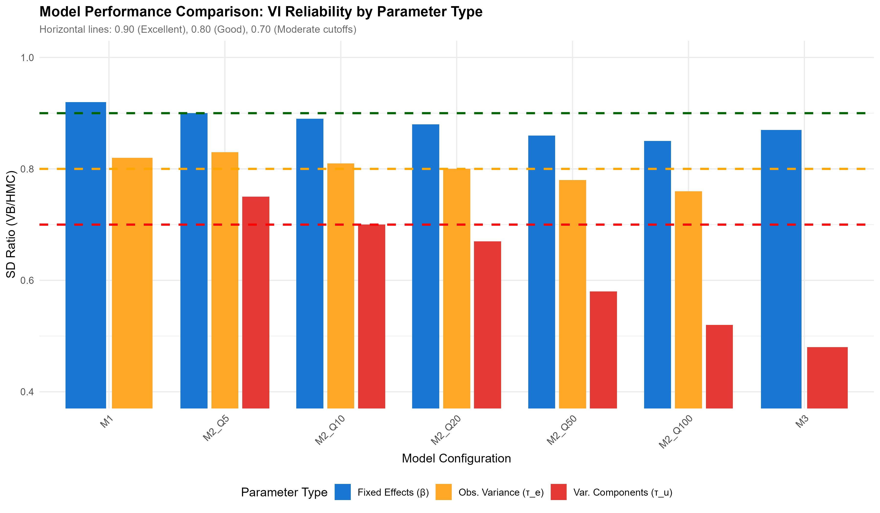

Slide 10
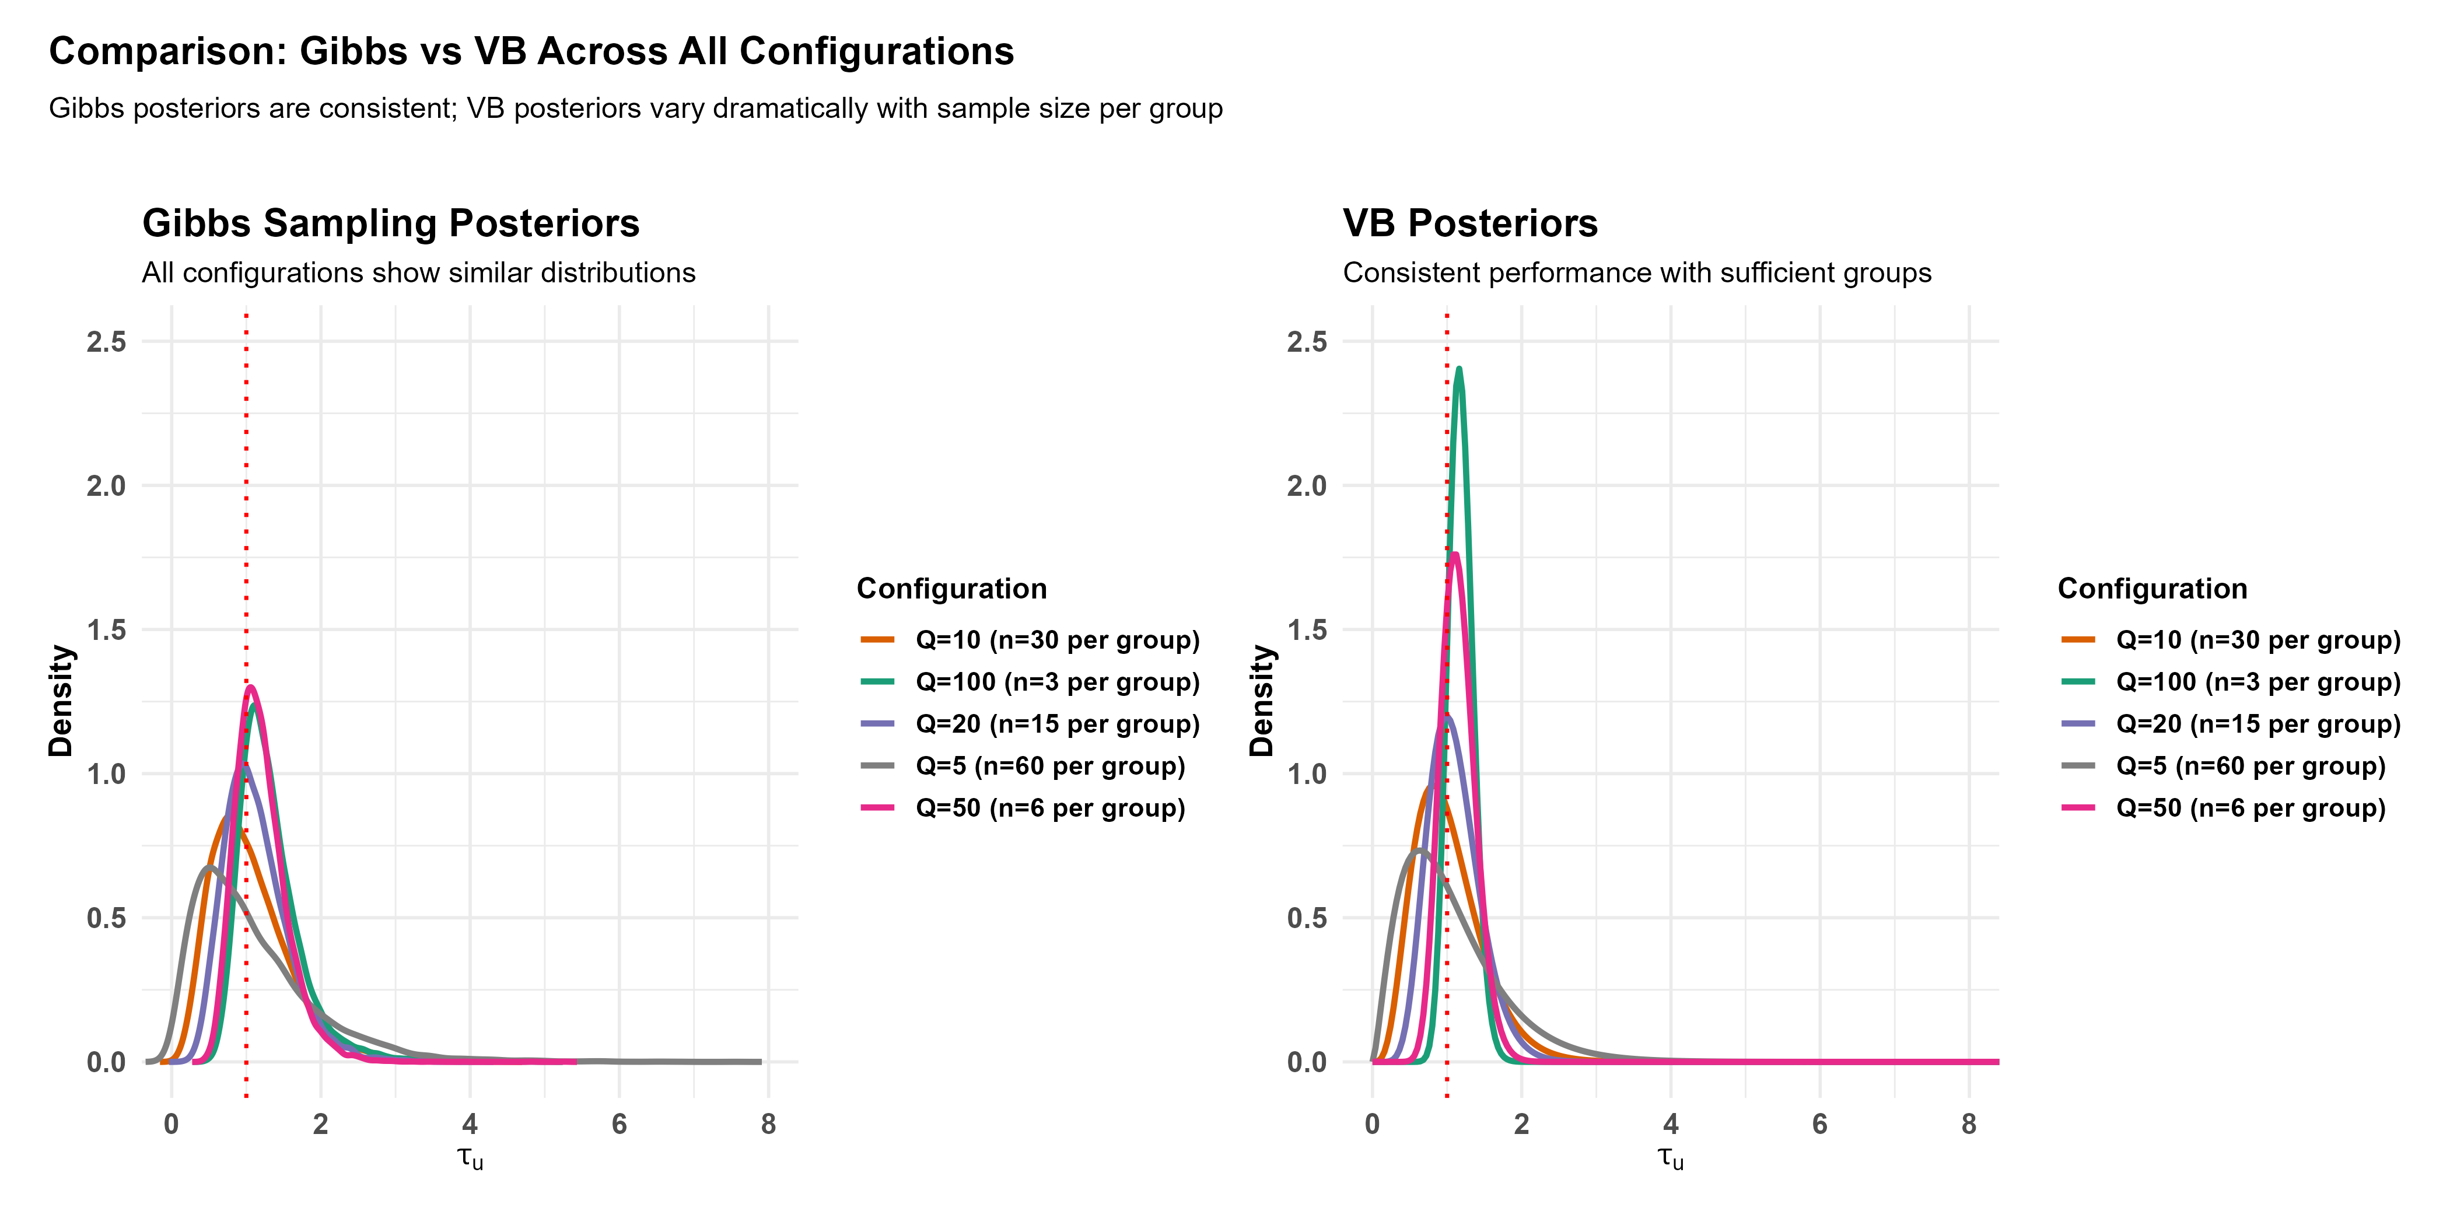

Slide 11
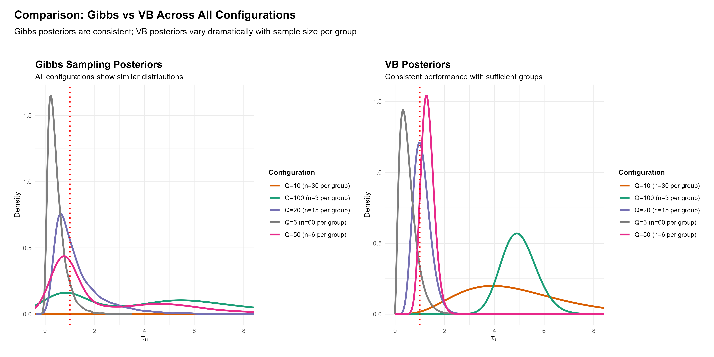

Slide 12
Parameter Types: What Can We Measure?
Fixed Effects (β)
Direct impact of predictors on outcomes
Predict individual outcomes and estimate effect sizes
Answer: 'How much does X change Y?'
VI Performance: Excellent to Good (0.85-0.95)
Observation Variance (τ_e or σ²)
Residual variation within groups
Assess model fit and prediction uncertainty
Answer: 'How precise are our predictions?'
VI Performance: Good to Moderate (0.75-0.85)
Variance Components (τ_u or σ²_u)
Between-group heterogeneity in hierarchical models
Assess if groups meaningfully differ
Answer: 'Do groups actually differ from each other?'
VI Performance: Poor to Very Poor (0.40-0.70)

Slide 13
Model Capabilities and Limitations
Model 1 (Linear Regression)
✓ Excellent for fixed effects (0.90-0.95)
✓ Good for observation variance (0.80-0.85)
✗ Cannot estimate variance components (no hierarchical structure)
Best for: Simple predictions without grouping
Model 2 (Hierarchical Linear)
✓ Good for fixed effects across all configurations
✓ Handles grouped/clustered data
⚠ Performance degrades with more groups (Q=5 better than Q=100)
✗ Poor variance component estimation at large Q
Trade-off: 30-50% too narrow intervals for τ_u
Model 3 (Hierarchical Logistic)
✓ Good for fixed effects (binary outcomes)
✓ Provides probability predictions
✗ Very poor for variance components (0.40-0.60)
Critical: Do not trust VI for random effects variance

Slide 14
Key Findings: The VI Reliability Hierarchy
Parameter-Selective Failure
Fixed effects (β): 85-95% of correct width → VI reliable
Observation variance (τ_e): 75-85% of correct width → VI acceptable
Variance components (τ_u): 40-70% of correct width → VI unreliable
Pattern: VI fails selectively as you move up the hierarchy
Sample Size Effects
M2_Q5 (5 groups): Moderate performance for τ_u (0.75)
M2_Q20 (20 groups): Caution required for τ_u (0.67)
M2_Q100 (100 groups): Poor performance for τ_u (0.52)
Larger hierarchical structures amplify under-dispersion
Speed vs Accuracy Trade-off
VI provides ~100-150× speedup over HMC
Fixed effects remain reliable despite speedup
Variance components sacrifice accuracy for speed
Must choose: fast inference or accurate uncertainty?

Slide 15
Practical Recommendations
When to Use VI Confidently
Model 1 for any purpose
Model 2/3 for fixed effects and predictions
Exploratory analysis requiring fast iteration
When computational resources are limited
When to Use HMC Instead
Model 2/3 for variance component inference
Critical decisions about between-group variation
Questions like 'How much do groups differ?'
Regulatory requirements or high-stakes inference
Hybrid Approach
Use VI for initial exploration and fixed effects
Verify variance components with HMC spot-checks
Document which parameters used which method
Practical rule: VI for means, HMC for variances

Slide 16
Real-World Example: Housing Prices
Question 1: Effect of Room Size
Uses fixed effect (β_rm)
VI estimate: β = 3.2 [2.8, 3.6]
HMC estimate: β = 3.2 [2.7, 3.7]
Conclusion: VI reliable for predictions
Question 2: Neighbourhood Variation
Uses variance component (τ_u)
VI estimate: τ_u = 0.5 [0.4, 0.6] ← 40% too narrow
HMC estimate: τ_u = 0.5 [0.3, 0.8] ← realistic
Conclusion: VI unreliable for between-group inference
Key Insight
Same model, different reliability by parameter
Must match method to question being asked
Speed advantage only valuable if answer is trustworthy

